Slide 1
The Case of Jane
Criteria, Assessment & Orders
© 2016 Thomas J. Davis Jr.

Slide 2
The Case of Jane
25 year old female with long Ψ history
Anoxic insult secondary to attempted suicide by hanging
Physically fit & vigorous
Over 100 facility admissions of widly varying duration

Slide 3
The Case of Jane
On scene EMTs recorded
Minimal CPR in progress
Ambu bag in use
5 respirations per minute
Intubate & provide O2
Color on departure: pale

Slide 4
The Case of Jane
Arrival in ER
Intubated and Ambu
Distended abdomen
Color of arrival: Ashen
Stabilized and transferred to ICU

Slide 5
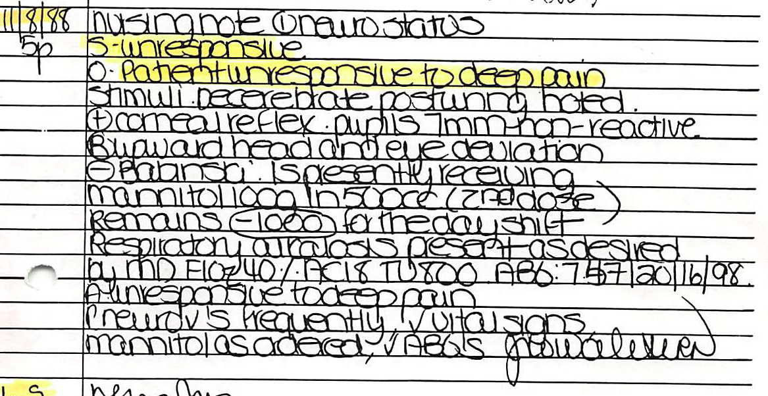
The Case of Jane

Slide 6
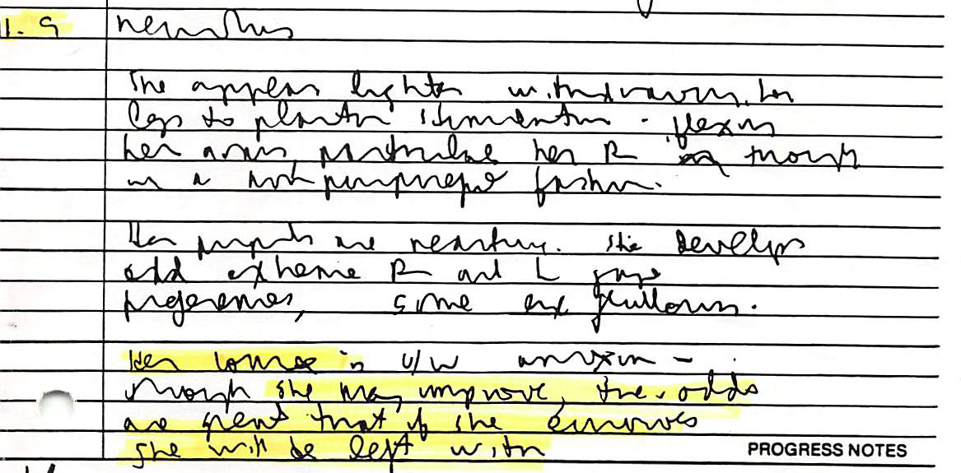
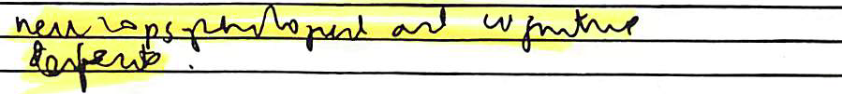
The Case of Jane
11/9

Slide 7

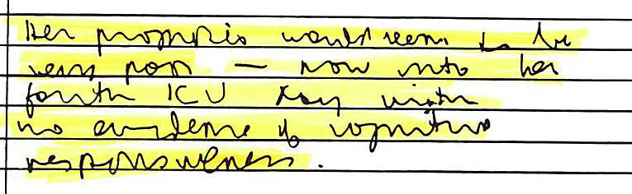
The Case of Jane

Slide 8
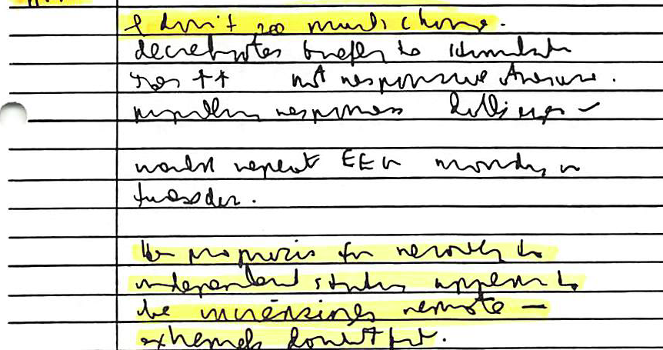
The Case of Jane
11/12

Slide 9
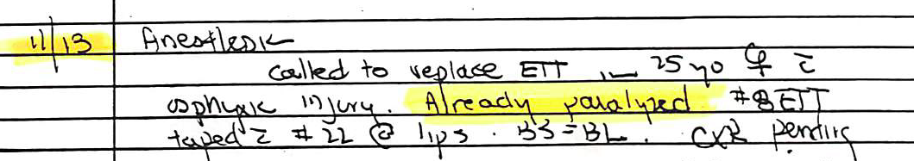
The Case of Jane

Slide 10
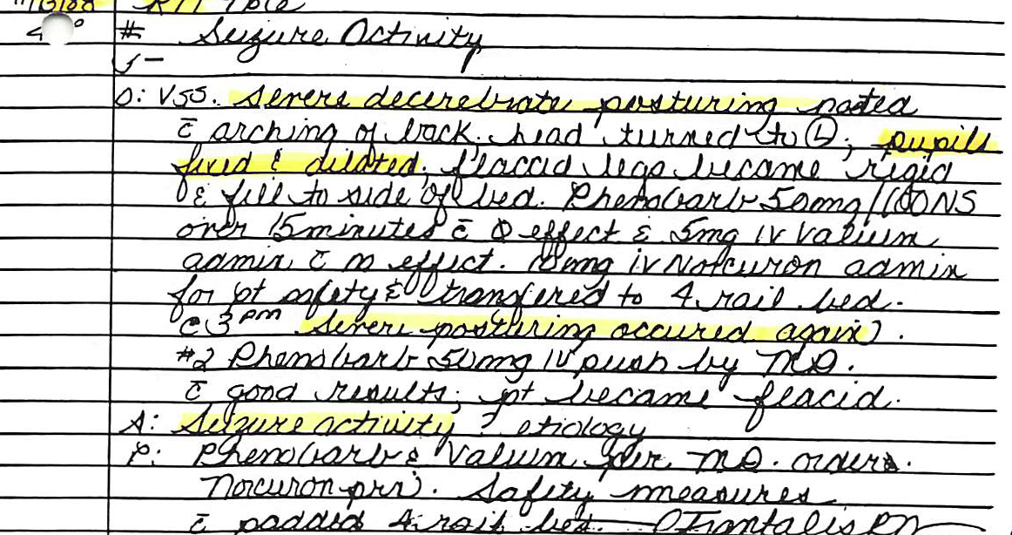
The Case of Jane
11/13 RN Note

Slide 11
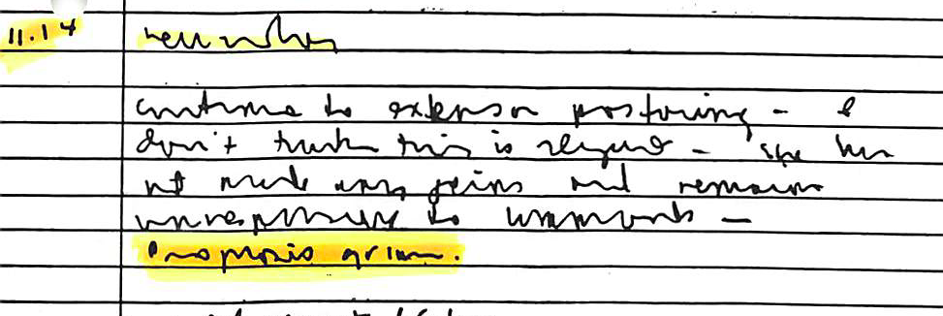
The Case of Jane

Slide 12
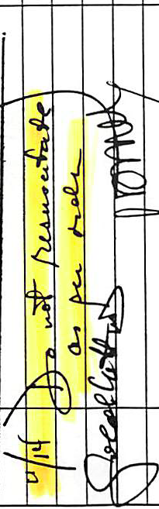
The Case of Jane
Physician’s Orders – Chart Top Right

Slide 13
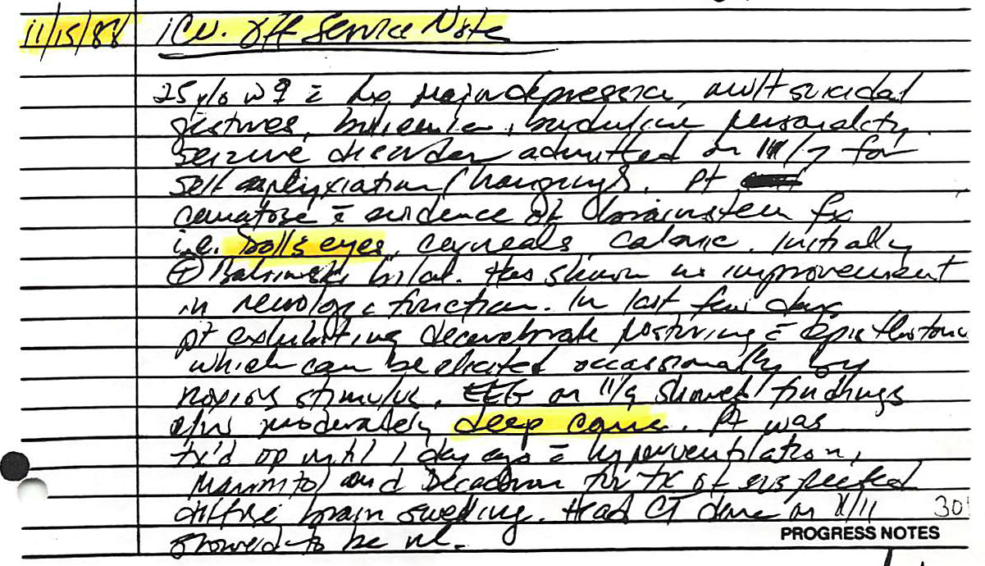
The Case of Jane

Slide 14
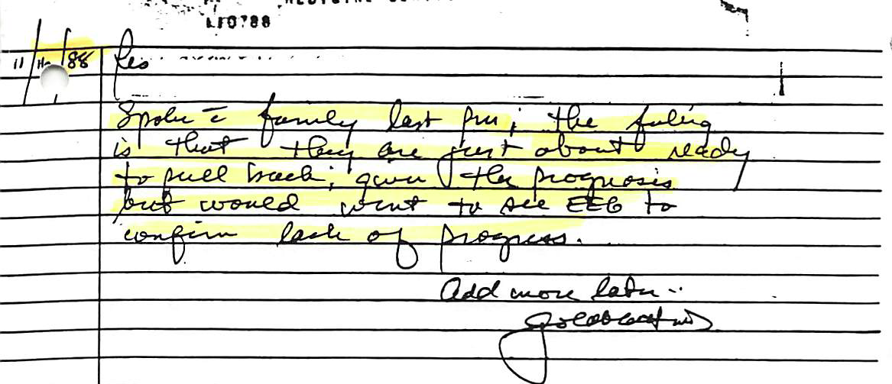
The Case of Jane

Slide 15
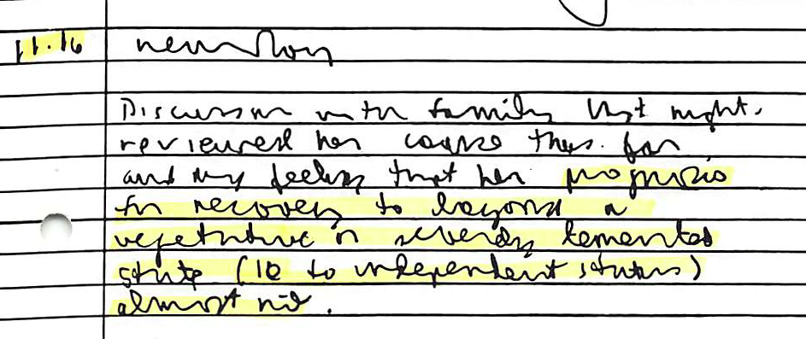
The Case of Jane

Slide 16

The Case of Jane
…

Slide 17
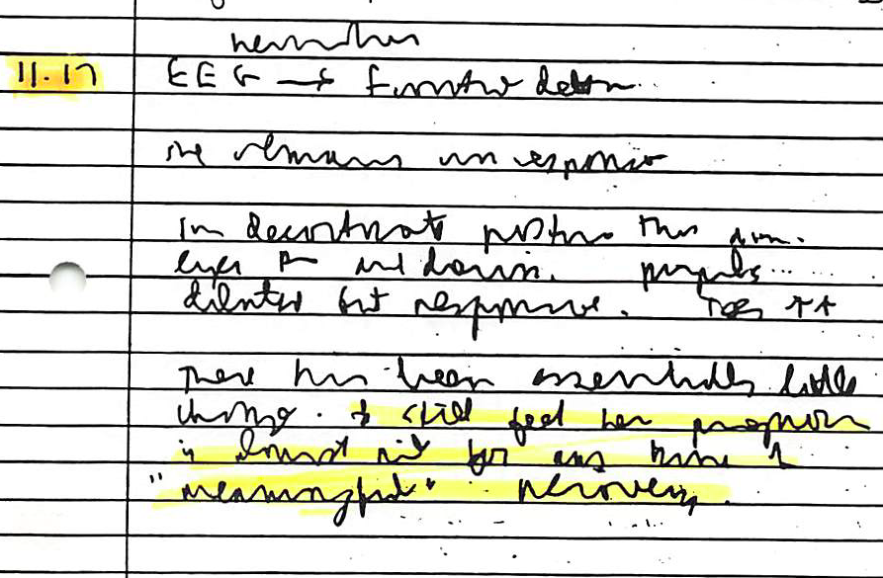
The Case of Jane

Slide 18
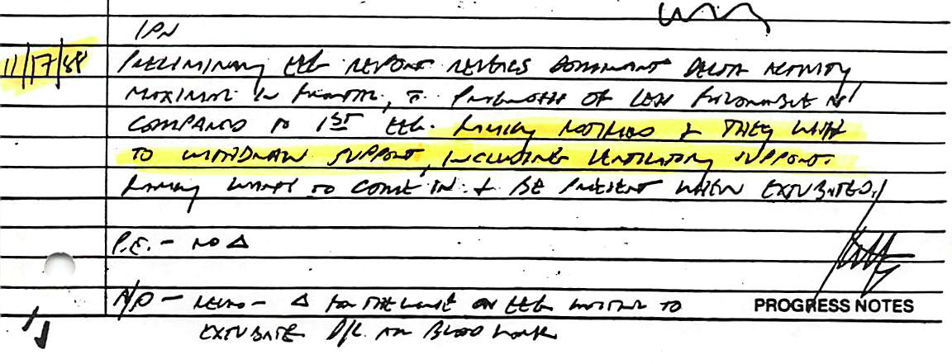
The Case of Jane

Slide 19
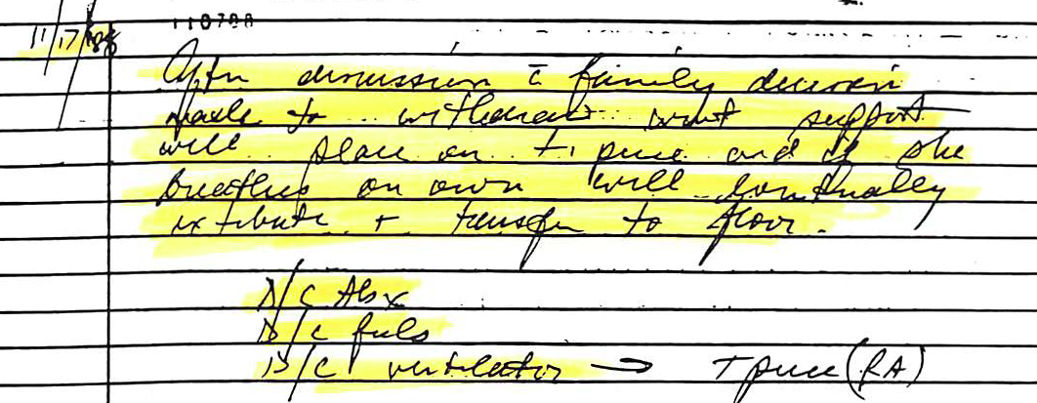
The Case of Jane

Slide 20
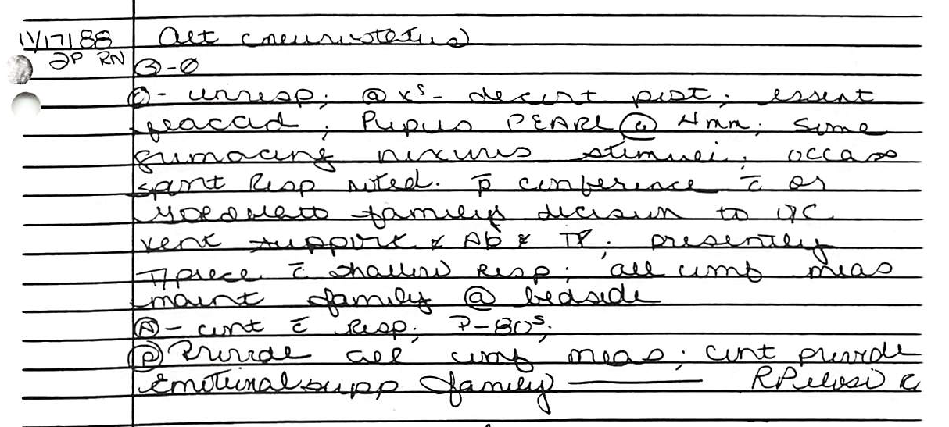
The Case of Jane

Slide 21
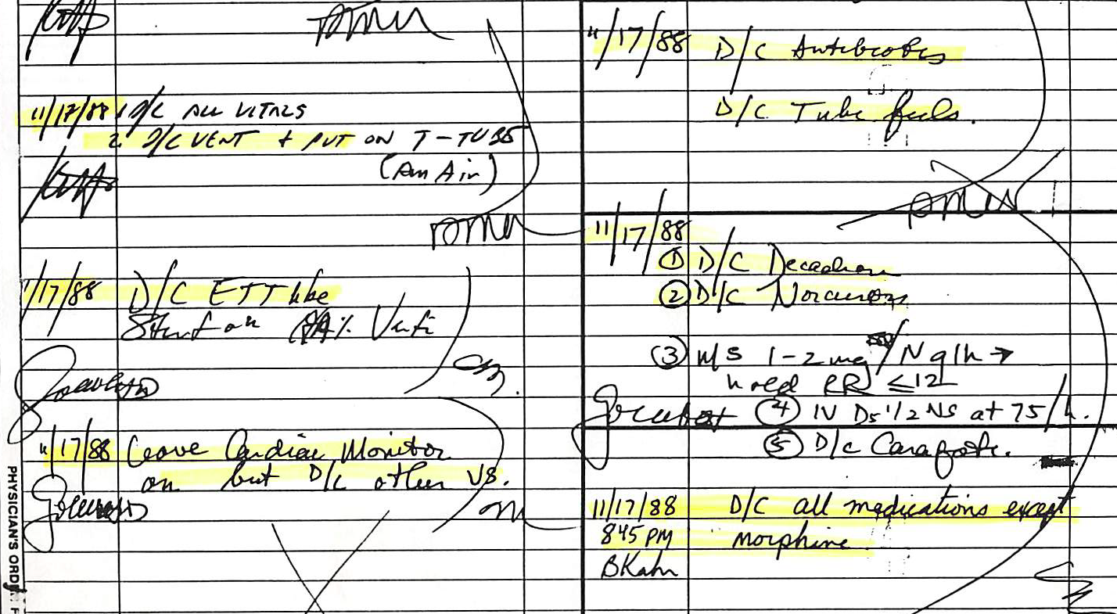

The Case of Jane

Slide 22
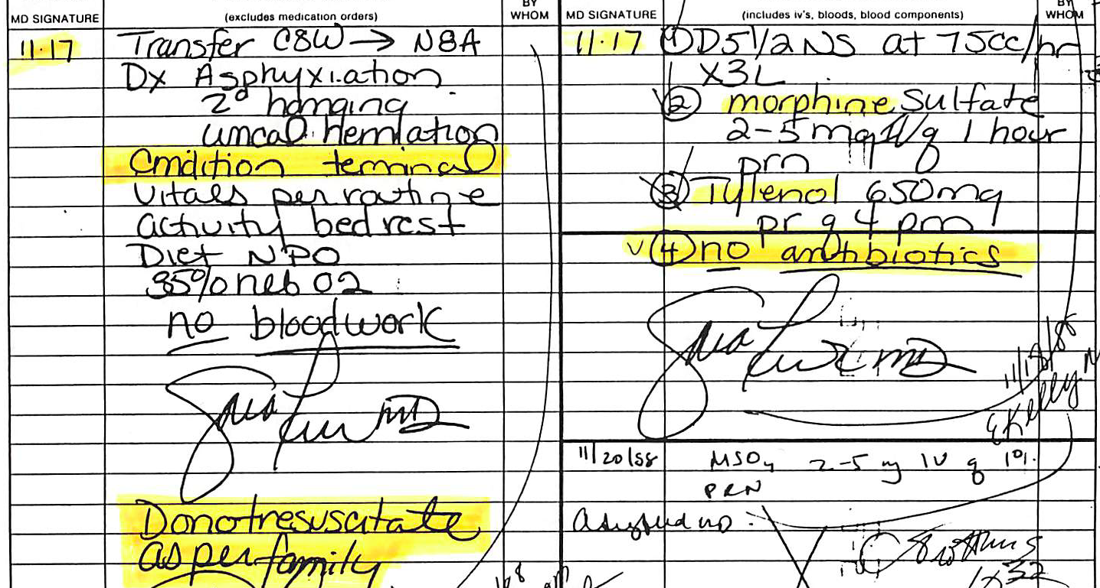
The Case of Jane

Slide 23
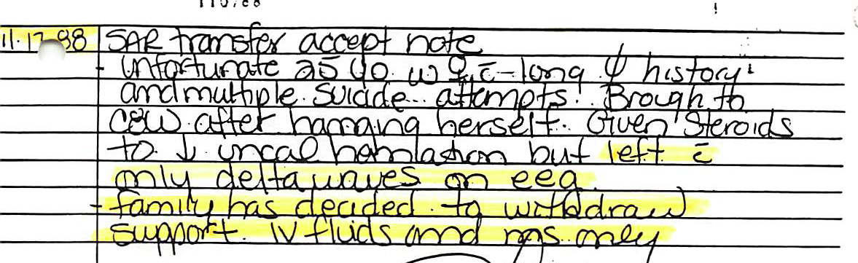
The Case of Jane

Slide 24
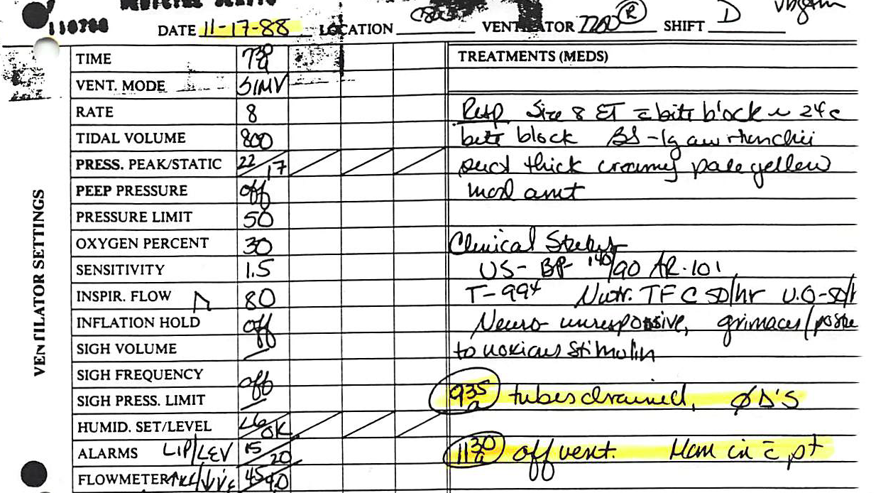
The Case of Jane

Slide 25
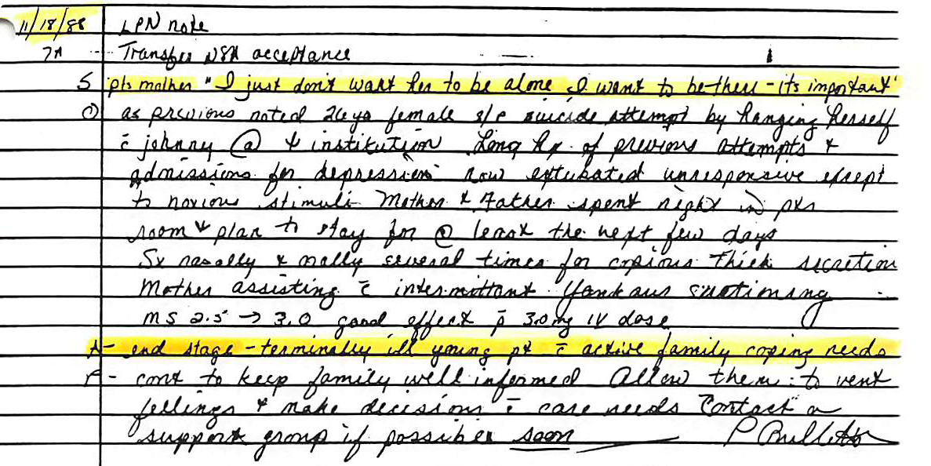
The Case of Jane

Slide 26
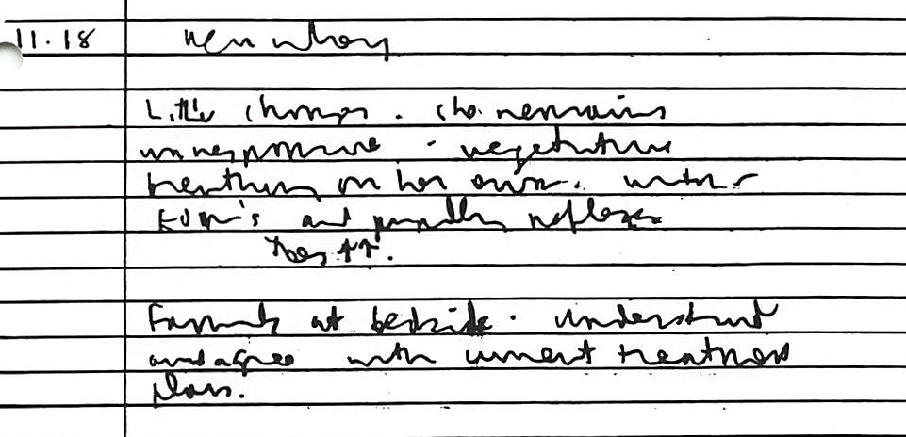
The Case of Jane

Slide 27
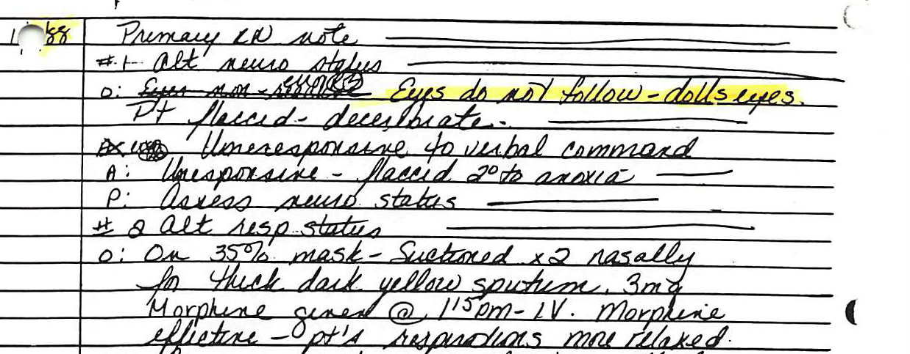
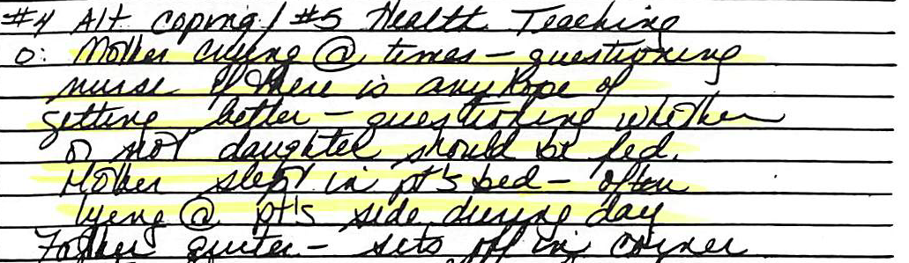
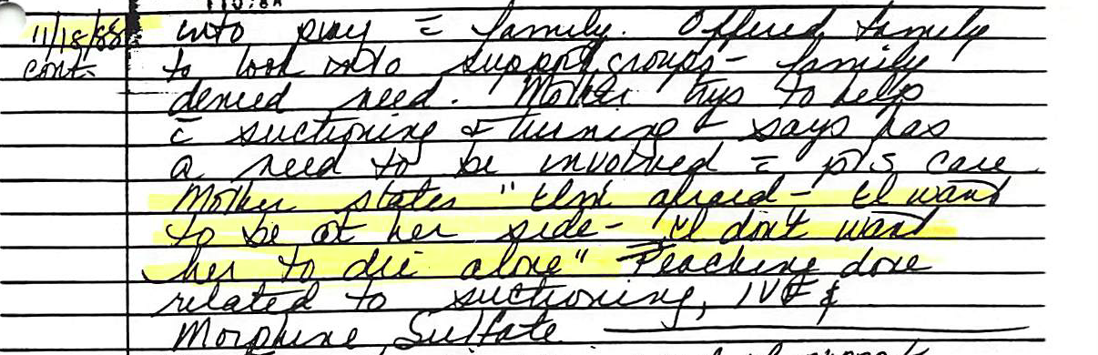
The Case of Jane
…
…

Slide 28
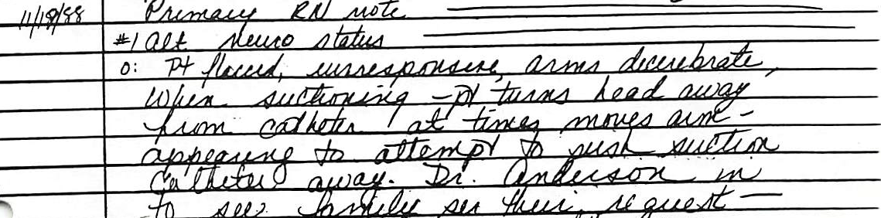
The Case of Jane
_________________________________________
…

Slide 29
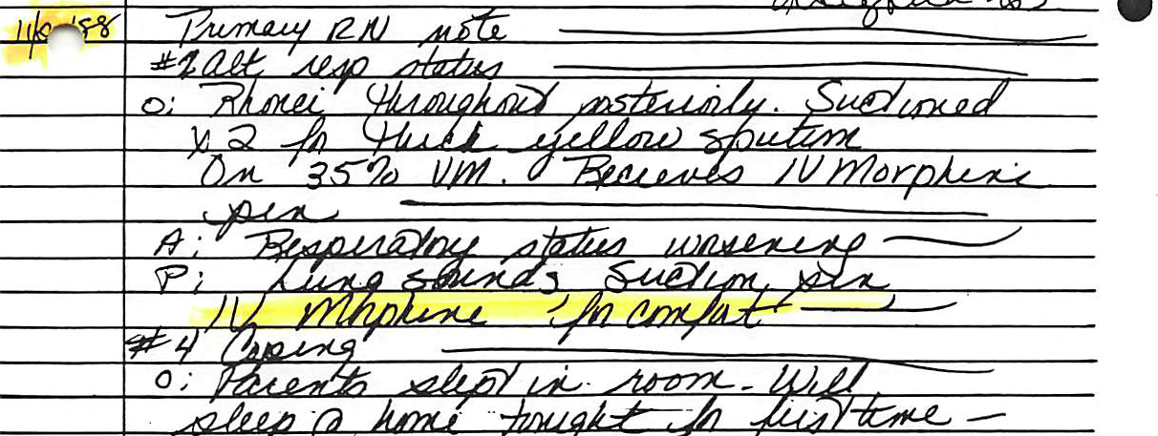
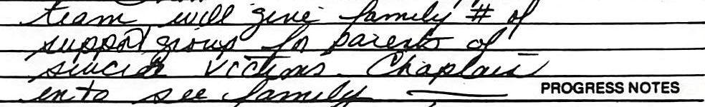
The Case of Jane
…

Slide 30
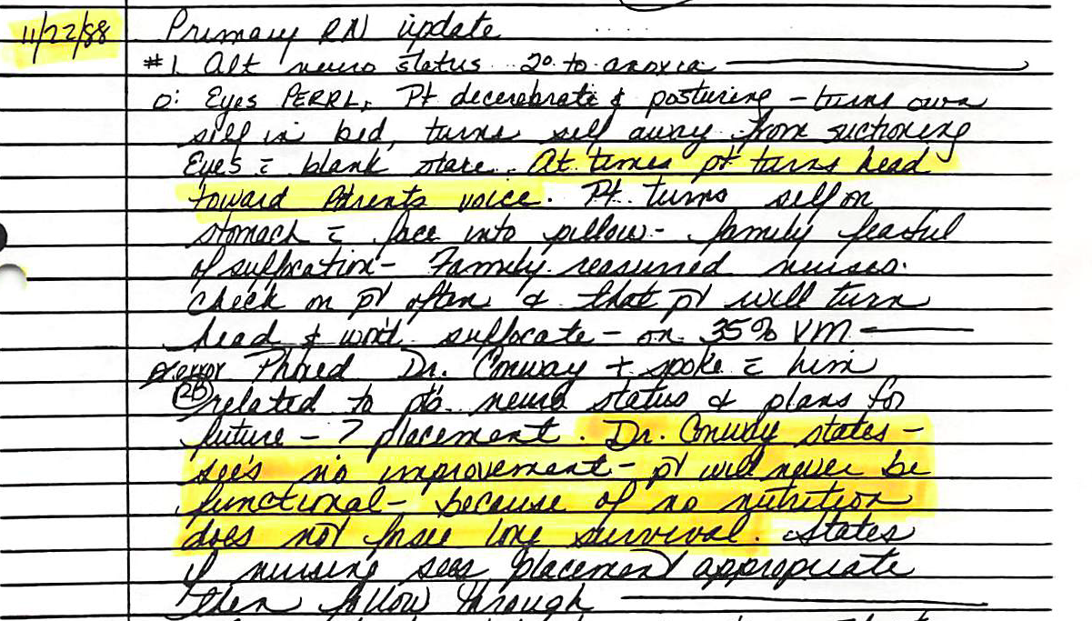
The Case of Jane

Slide 31
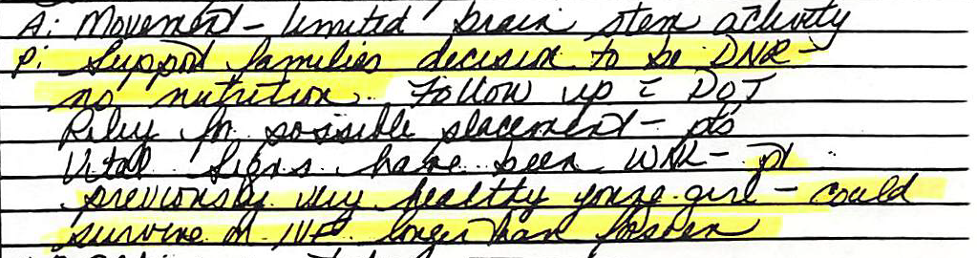
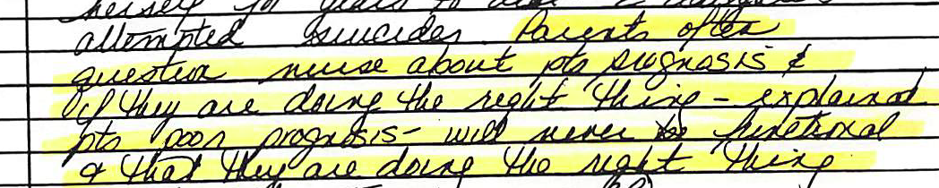
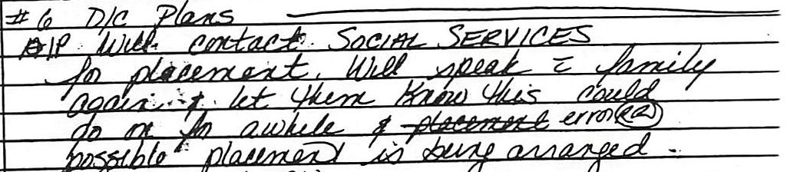
The Case of Jane
11/22 Primary RN Update continued

Slide 32
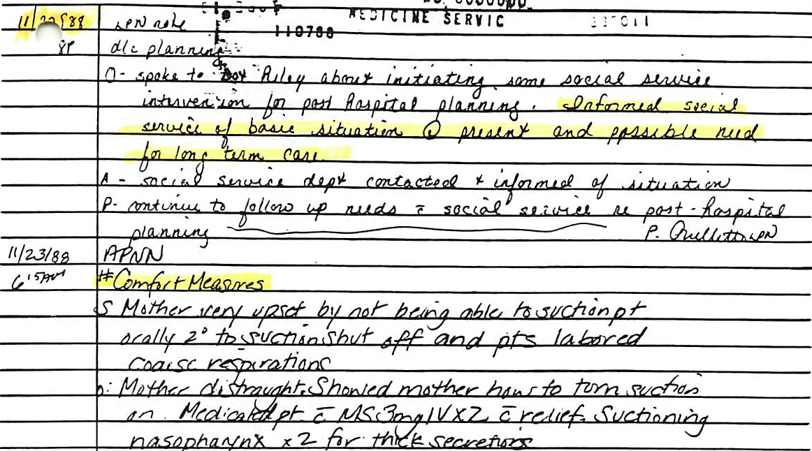
The Case of Jane

Slide 33
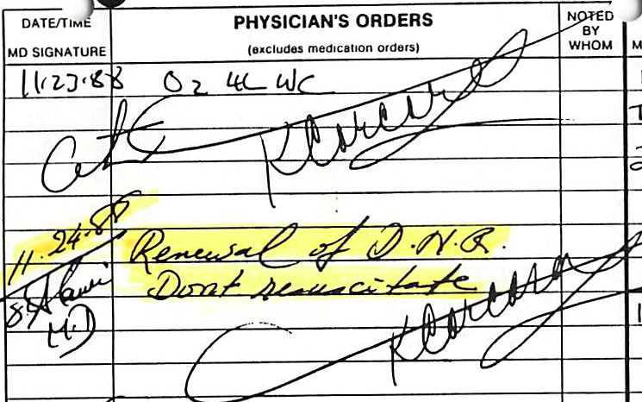
The Case of Jane

Slide 34
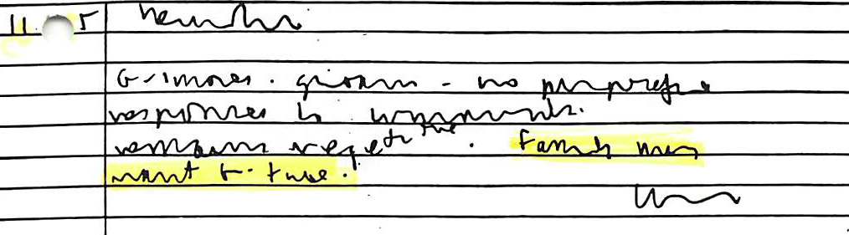
The Case of Jane
11/25

Slide 35
The Case of Jane
11/8: Injury
11/14: DNR (Day 7)
11/17: “Condition terminal” (Day 10)
11/17: D/C
        Ventilator
        Antibiotics
        Tube Fluids
        All medication except morphine
    11/24: DNR renewed
    11/25: Now day 18.

Slide 36
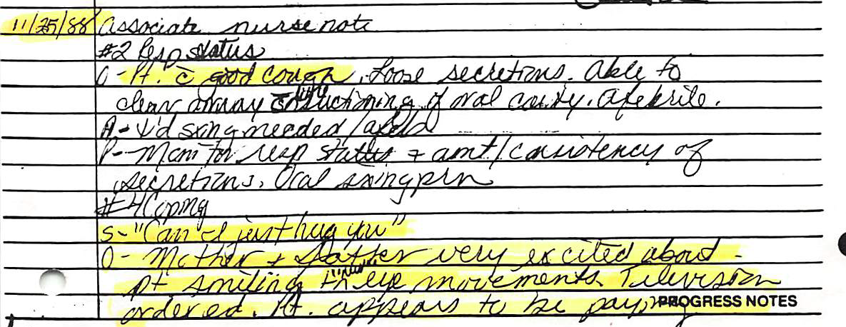

The Case of Jane

Slide 37
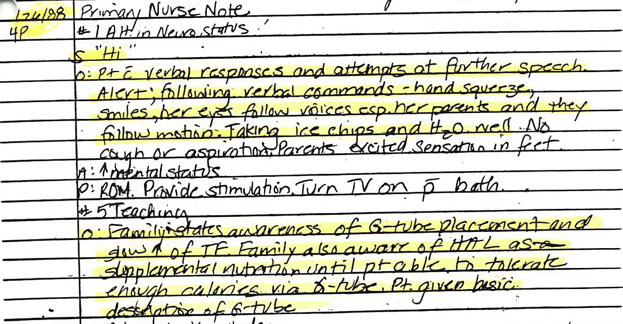
The Case of Jane

Slide 38
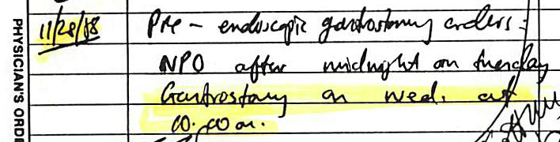

The Case of Jane

Slide 39
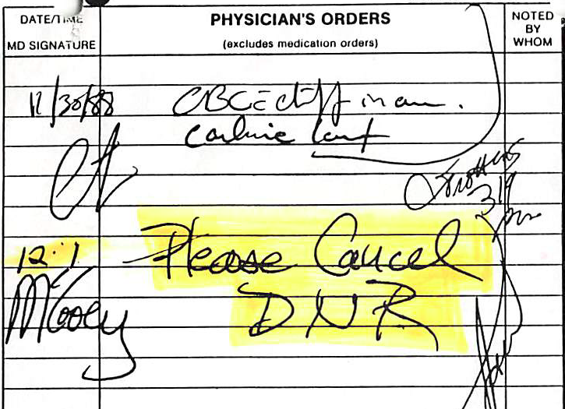
The Case of Jane
12/1: Six days after saying “Can I just hug you?”

Slide 40
The Case of Jane
Jane survived with profound brain damage
Lives entirely in the moment
Memories erase as experienced. No memory of her past mental health & suicidality
Unknown if that may restore
Cognitive ability demonstrated in “Things That Float” video.
Walk and talk but very limited vocabulary
Feeds self
Assisted at times with basic tasks: e.g. brushing teeth
Has benefit of various occupational, speech & physical therapy
Has substantial means for support & Special Needs Trust

Slide 41
The Case of Jane
Raises many questions about Advance Directives
    “Terminal”
    “End stage”
    DNR
    Morphine
    Assisted Nutrition & Hydration
    “Quality of Life” judgments
    Advance decision making (Charles Krauthammer’s “sunny summer afternoon”)
    And many issues related to basic medical ethics
Autonomy & Proxy
Truth Telling
Beneficence
Justice
Non-malfeasance
Non-abandonment

